Slide 1


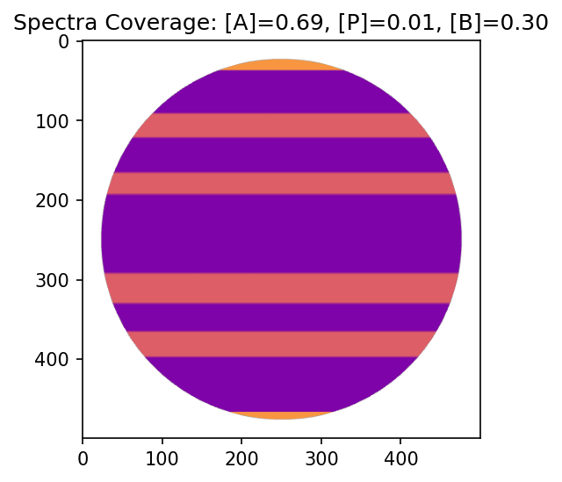
A
Photometric prediction
B
Polar region not visible, small polar flux
Polar region visible, large polar flux
i = 0°
i = 20°
i = 20°
Spectrophotometric prediction
C
i = 0°
i = 20°
E
D
Final Spectra
Band Spectra
Polar Spectra
Spectral Lookup Map
Spectral Lookup Map

Slide 2
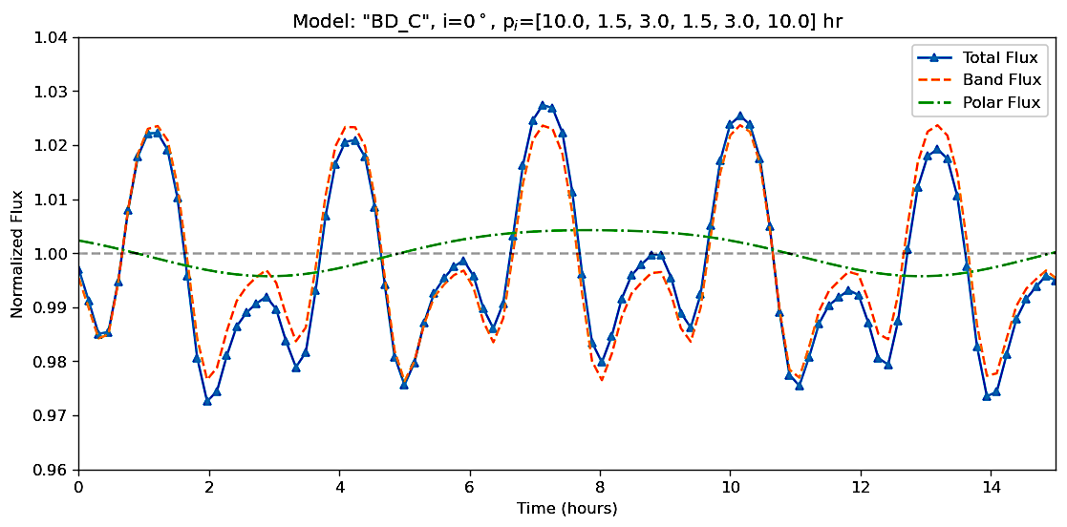
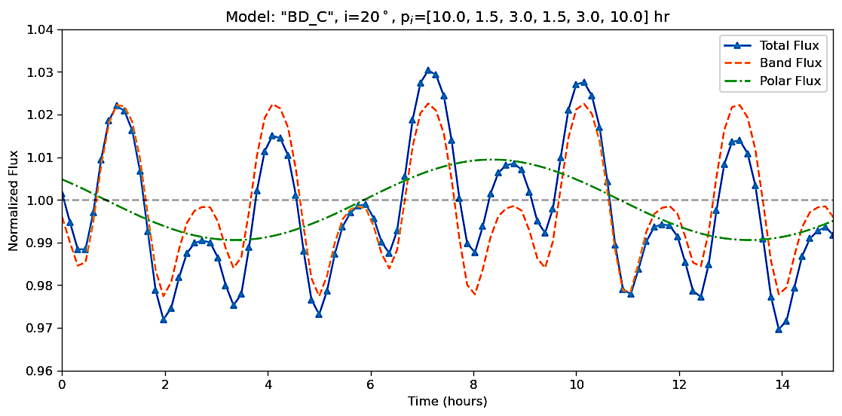
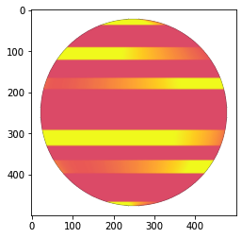
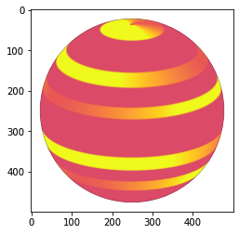
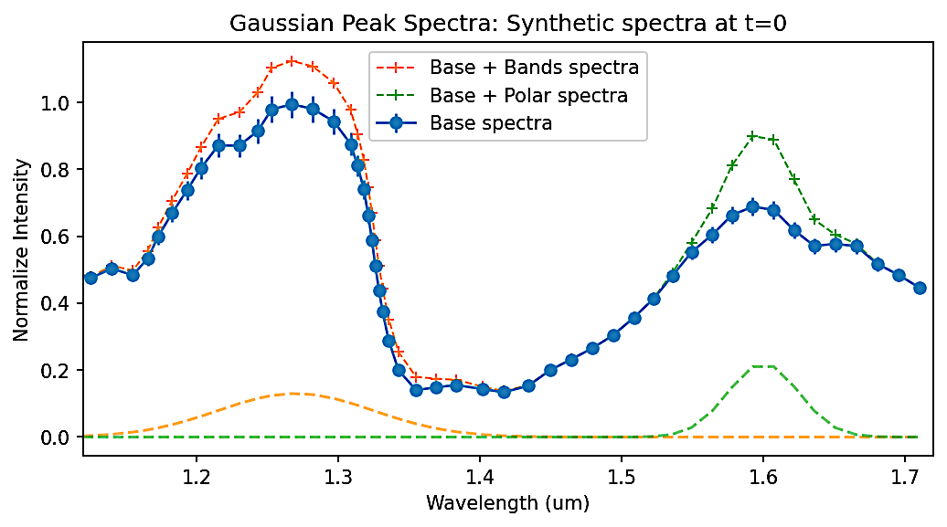
Photometry
Polar region not visible, small polar flux
Polar region visible, large polar flux
A
B
i = 0°
i = 20°
Spectroscopy
C
i = 0°
D
i = 20°
E
Band Spectra
Polar Spectra
Spectral Lookup Map
Spectral Lookup Map

Slide 3











